Slide 1
Outland Adventures
William Alspaugh, Celine Del Mundo, Daniel Kissner, Dylan Rule
CSD 310 | Module 11

Slide 2





Meet Team Alpha
Celine Del Mundo
William Alspaugh
Dylan Rule
Daniel Kissner

Slide 3
Outland Adventure Case Study
Blythe Timmerson and Jim Ford set out to cater to those who love hiking and camping around the world. To ensure their business’ growth and success, they needed the right talent and information.
The three most important data points Blythe and Jim highlighted were:
Equipment Sales – were they generating enough profit to be viable?
Location Trends – were any locations experiencing a downward trend?
Inventory Age – Were any pieces of equipment over 5 years old?

Slide 4
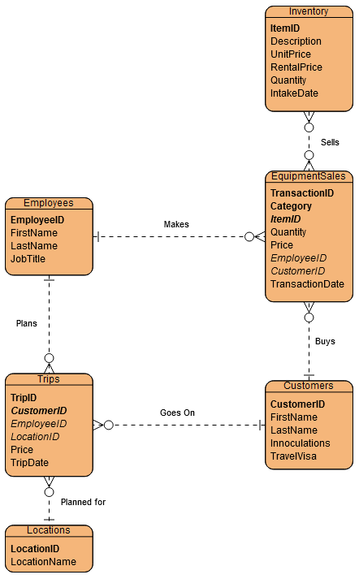
ERD
The ERD shows how each entity interacts with each other throughout the organization. It visualizes how they intertwine with one another, documenting their relationships.

Slide 5
Business Rules
One employee can make many sales.
Many inventory items can be sold many times.
One Customer can make many purchases.
One customer can go on many trips.
Many Trips can be taken to one location.
One employee plans many trips.

Slide 6

Assumptions
Outland Adventures would like to track what locations are trending each year compared to the previous year to anticipate popular locations and adjust their marketing strategies.
Blythe and Time want to view reports on sales of equipment vs rentals to make decisions on whether to keep sales of certain items and only allow those items to be rented.
The business would like to track the age of items in their inventory to ensure quality is up to standard.

Slide 7
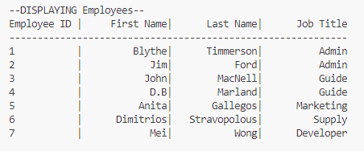
Employees
The 7 employees that run the organization.

Slide 8
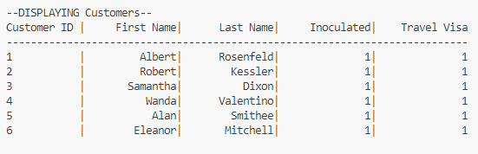
Customers
Customers that booked trips through Outland Adventures

Slide 9
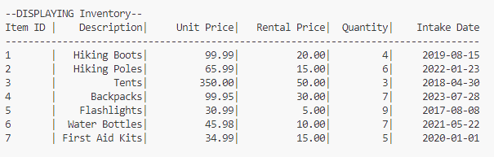
Inventory
Common equipment needed while hiking. The table includes both sale and rental prices, as well as the item’s intake date.

Slide 10
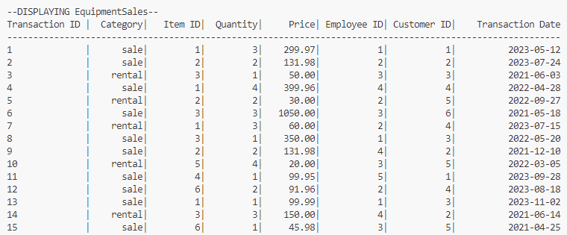
Equipment Sales
Sales made by Outland Adventures to customers. This table shows revenue generated by equipment sales.

Slide 11
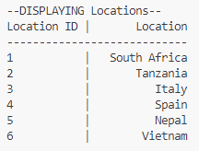
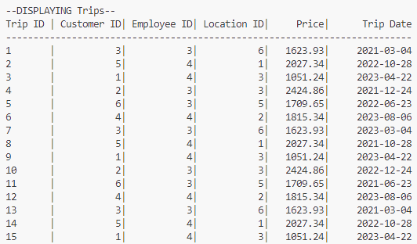
Locations and Trips
Locations are routed as unique IDs that occur in the Trips table. The Trips table includes prices and the trip’s date.

Slide 12
Question #1 Query
Do enough customers buy equipment to keep equipment sales?
SELECT
i.ItemID,
i.Description,
COALESCE(YEAR(s.TransactionDate), {year}) AS SalesYear,
SUM(CASE WHEN s.Category = 'sale' THEN s.Quantity ELSE 0 END) AS TotalSalesQuantity,
SUM(CASE WHEN s.Category = 'sale' THEN s.Price ELSE 0 END) AS TotalSalesAmount,
SUM(CASE WHEN s.Category = 'rental' THEN s.Quantity ELSE 0 END) AS TotalRentalsQuantity,
SUM(CASE WHEN s.Category = 'rental' THEN s.Price ELSE 0 END) AS TotalRentalsAmount
FROM Inventory I
LEFT JOIN EquipmentSales s
ON i.ItemID = s.ItemID AND YEAR(s.TransactionDate) = {year}
GROUP BY i.ItemID, i.Description, SalesYear;

Slide 13
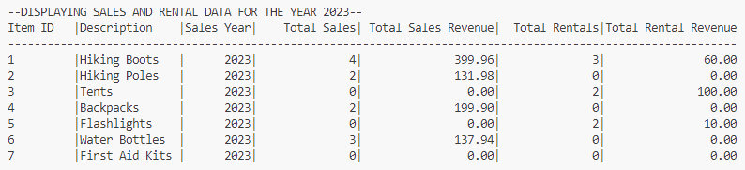
Sales & Rental
The Sales and Rental data of a specific year for each inventory item. This is meant to help the business decide whether on not keeping equipment sales makes sense from a business standpoint.

Slide 14
Question #2 Query
Do any of the trip locations have a downward trend in bookings?
SELECT
l.LocationID,
l.Location,
COUNT(CASE WHEN YEAR(t.TripDate) = {year - 1} THEN t.TripID END),
COUNT(CASE WHEN YEAR(t.TripDate) = {year} THEN t.TripID END),
CASE
WHEN COUNT(CASE WHEN YEAR(t.TripDate) = {year} THEN t.TripID END) > COUNT(CASE WHEN YEAR(t.TripDate) = {year - 1} THEN t.TripID END) THEN 'Rise’
WHEN COUNT(CASE WHEN YEAR(t.TripDate) = {year} THEN t.TripID END) < COUNT(CASE WHEN YEAR(t.TripDate) = {year - 1} THEN t.TripID END) THEN 'Fall’
ELSE 'No Change’
END
FROM Locations l LEFT JOIN Trips t
ON l.LocationID = t.LocationID
GROUP BY l.LocationID, l.Location;

Slide 15
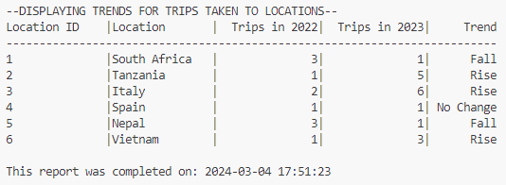
Amount of Trips
The amount of trips taken to a location are included to whether there are upward or downward trends in booking for each location.

Slide 16
Question #3 Query
Are there items in inventory that are over five years old?
SELECT ItemID, Description, TRUNCATE(DATEDIFF(CURDATE(), IntakeDate)/365, 0)
FROM Inventory
WHERE DATEDIFF(CURDATE(), IntakeDate)/365 >= 5;

Slide 17
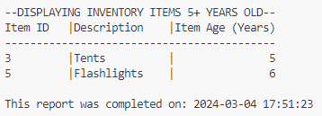
Old Inventory
Inventory that has been in the system for over 5 years

